Slide 1




INDUSTRIAL USE CASES PREDICTIVE MODELLING ANALYTICS
--Your Name---
IV-ECE ‘A’ - VII SEM

Slide 2

PROBLEM STATEMENT
In FMCG industries the main problem’s which are faced now-a-days are Storage management ,amount of procurement of products and proper distribution channels to clear the stocks in warehouse.
And another more importent problem faced by the FMCG industries are the decaying products which are not handled properly.

Slide 3
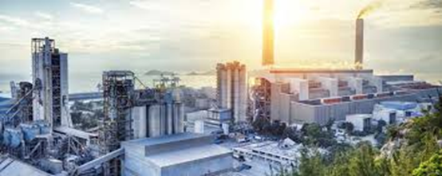
ABOUT INDUSTRY:
INDUSTRY NAME: FMCG
EXPLANATION:
FMCG – stands for Fast Moving Consumer Goods.
Fast-moving consumer goods are products that sell quickly at relatively low cost. These goods are also called consumer packaged goods.
FMCGs have a short shelf life because of high consumer demand (e.g., soft drinks and confections) or because they are perishable (e.g., meat, dairy products, and baked goods).
These goods are purchased frequently, consumed rapidly, priced low, and sold in large quantities. They also have a high turnover when they're on the shelf at the store.

Slide 4

SOLUTION
Some of the solutions which can be used with the help of predictive modeling are,
Use of predictive analysis to analyse the demand and forecast it.
Use of predictive analysis to find and push the products which has the possibility of decaying sooner.
Use of predictive analysis to calculate traffic of goods.

Slide 5

SOLUTION EXPLANATION
From the above problem statements which are faced in the FMCG industries such
Demand Forecasting
Product’s State
Traffic of Goods

Slide 6
DEMAND FORECASTING
Utilizing predictive modeling in FMCG demand forecasting optimizes inventory management. By analyzing historical data, market trends, and external factors, such as seasonality and promotions, accurate predictions can be made. This enhances supply chain efficiency, reduces stockouts, and ensures timely delivery, ultimately boosting customer satisfaction and company profitability.

Slide 7
PRODUCT STATE
As we all know , most of the product which are used in the FMCG industry such as egg , milk and fruits are decaying products so we have to fast track the movement of the product based on their current state and dispose which cannot reach the customer on time.
We can with the help of predictive modeling ,atomate this sector as to classify and fast track the movement of the goods.

Slide 8
TRAFFIC OF GOODS
When there is more than one of channel of distribution is running in a area we see that there will be a surplus in the flow of goods and some other region which will see a decrease in the availability of goods.
As to avoid this situation we use predictive modeling to build a model which can be used to monitor and predict the surplus and scarcity of goods in region.

Slide 9

THANK YOU!

